Slide 1
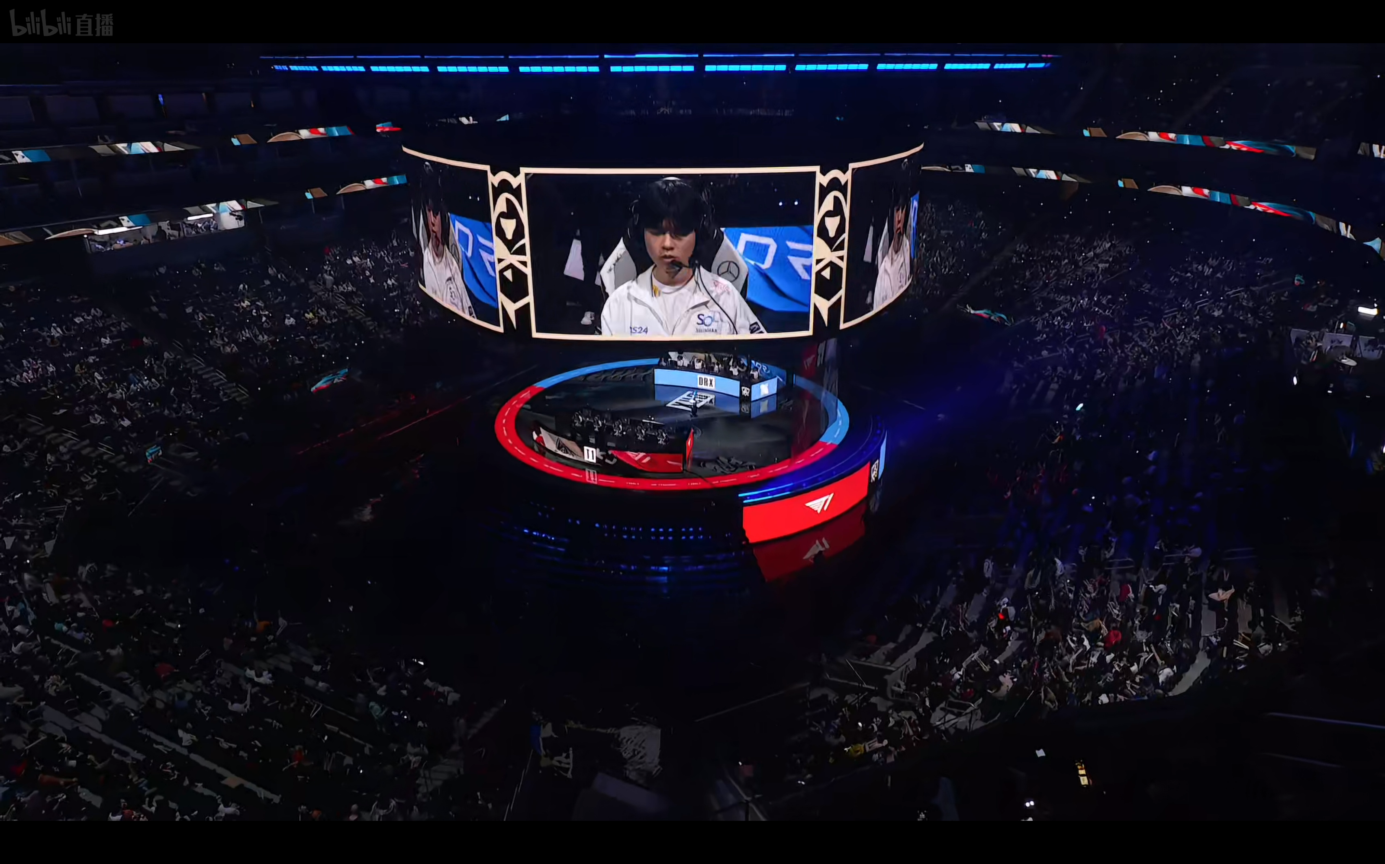
E-SPORTS

Slide 2

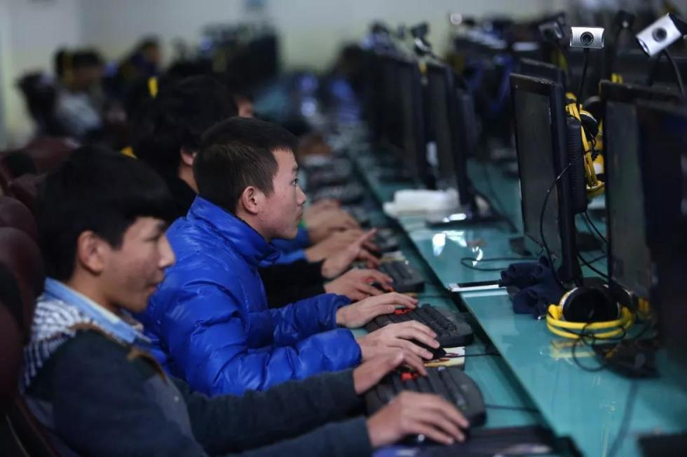
What comes to your mind?

Slide 3
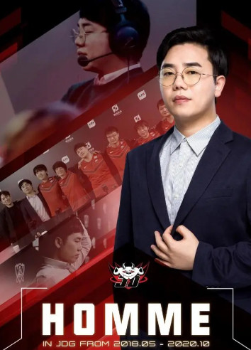
The components of a e-sports team
Players
Coaches team
Nutrition analysts
Logistic staff
…

Slide 4
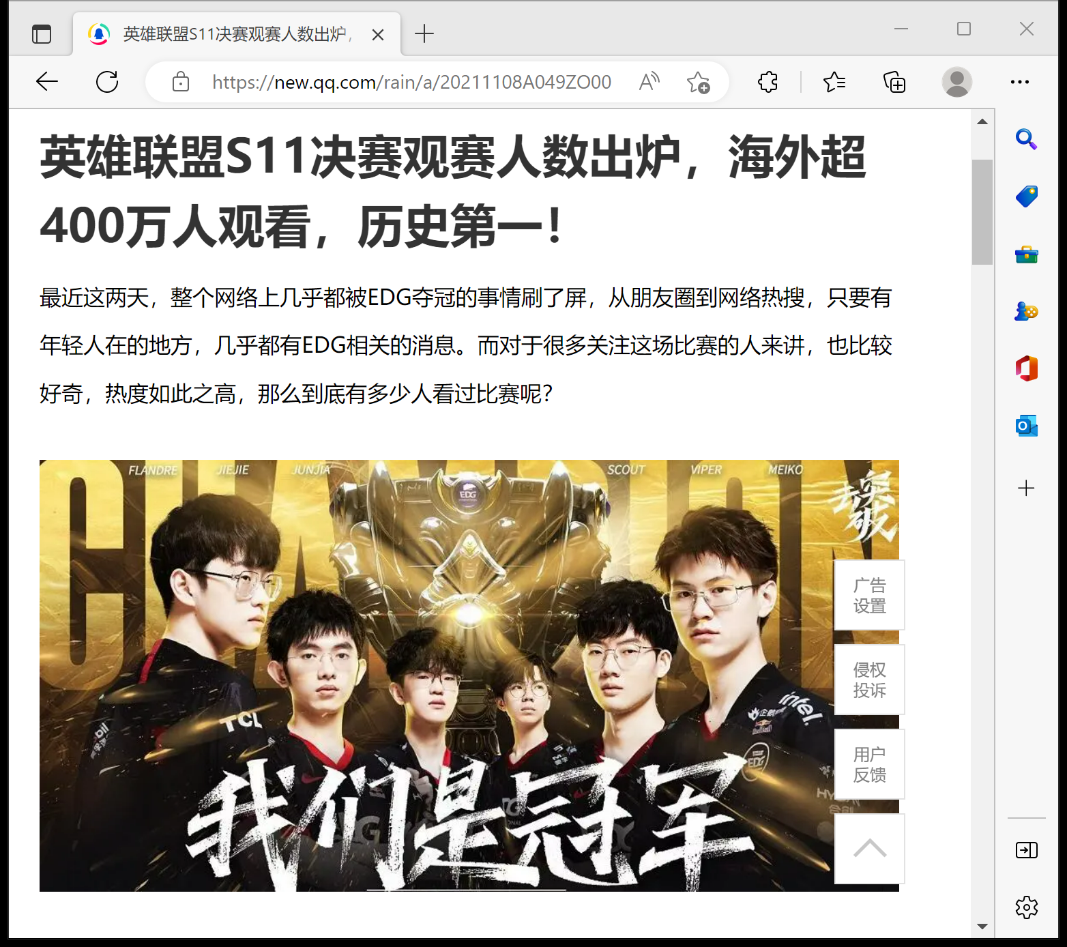
Will anyone really go to see it? Does the e-sports make sense?

Slide 5
